Slide 1
Term Project Milestone 2
Milan Sherman

Slide 2
Are the Dallas Cowboys really “America’s Team”?
The Dallas Cowboys have been dubbed “America’s Team”, implying that they are the most popular NFL team in the nation.
As a Pittsburgh Steelers fan, I question this assertion. As long as I have been following the Steelers, they seem to have a very broad fan base; they often have more fans in attendance at an away game than the home team, and I notice people wearing Steelers merchandise across the country.
This evidence is admittedly anecdotal and likely biased.
Since, however, the Steelers have never been given a title that would imply that they are more popular than any other team, I thought it would be more interesting to test the claim that the Cowboys are.

Slide 3
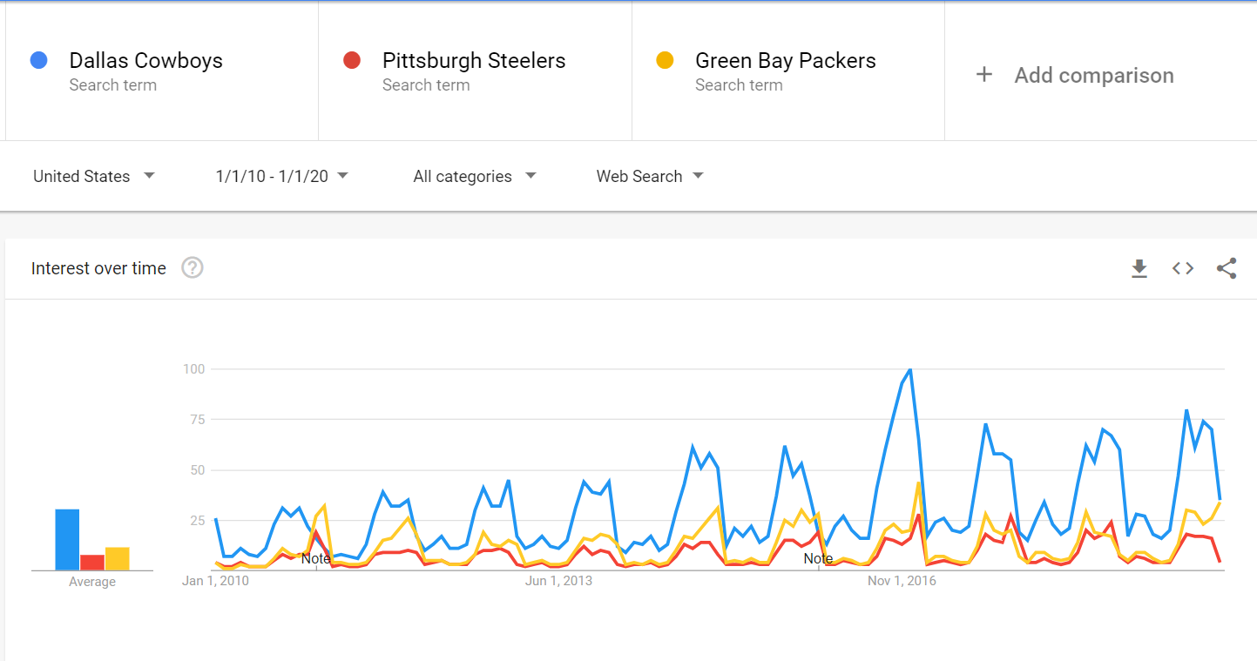
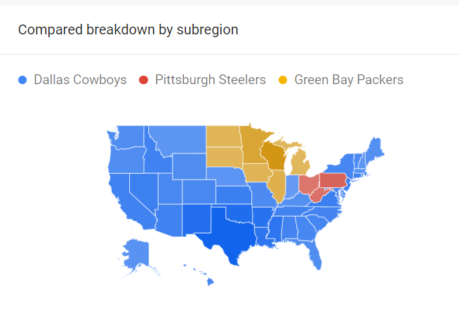
General popularity based searches by team name
In terms of web searches using
each of these teams as a search term
it appears that the Cowboys have
generated more interest than the
Steelers and the Packers.
There is a clearly a seasonal pattern
corresponding to the NFL football
season, but even during the offseason the Cowboys seems to have been more popular.
In addition, looking at searches across the U.S., the Steelers and Packers popularity seems to be regional, while the Cowboys popularity extends beyond the region surrounding Texas.

Slide 4
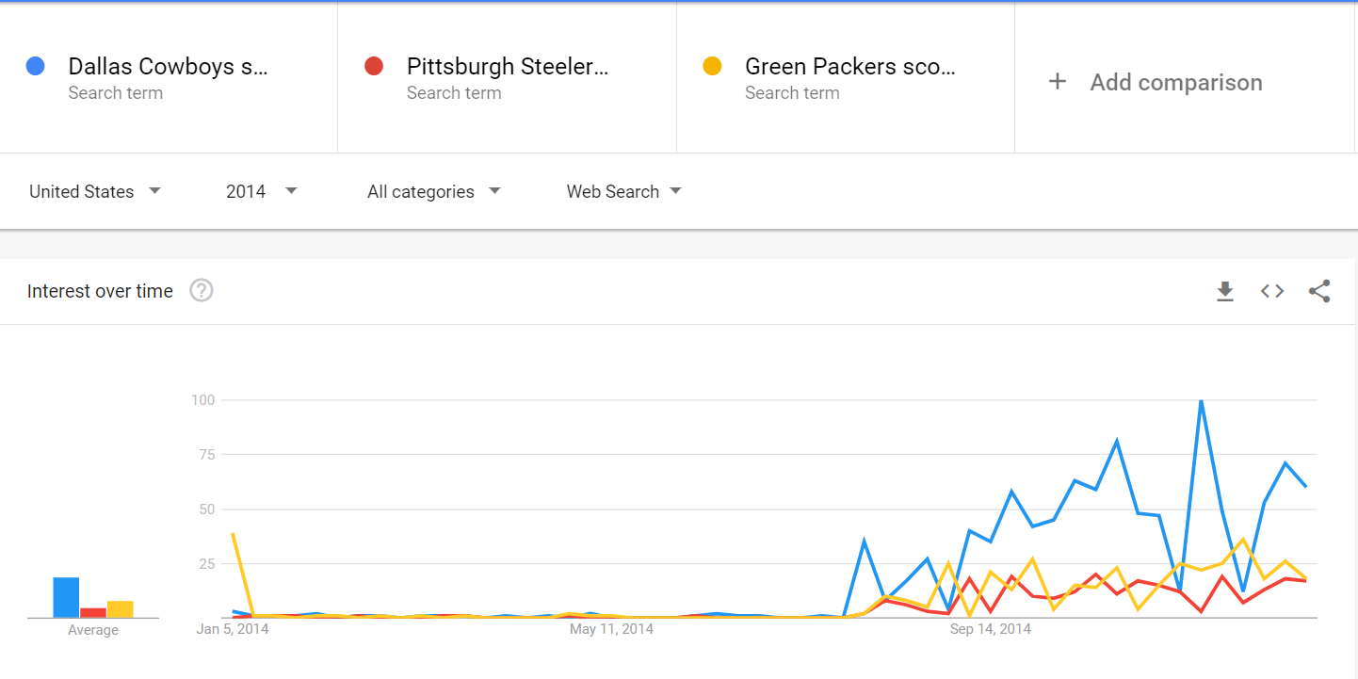
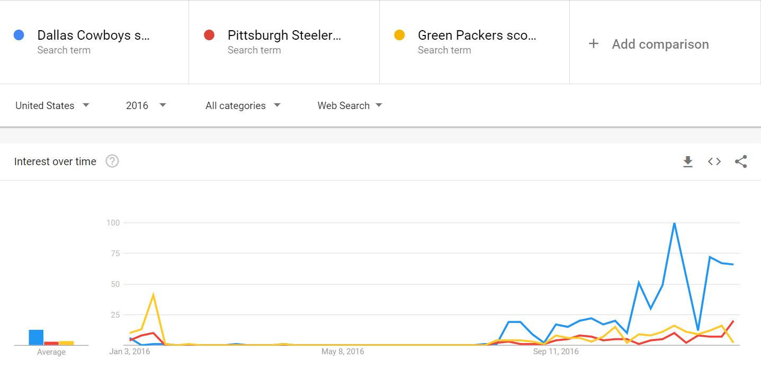
Popularity during successful seasons
In order to make more fair comparisons, we can examine the popularity of seasons where all three of these teams made playoffs
Many times fans can lose interest if their teams are not doing well
However, in two seasons where all three teams were having a winning season and going to the playoffs, the Cowboys are clearly more popular

Slide 5
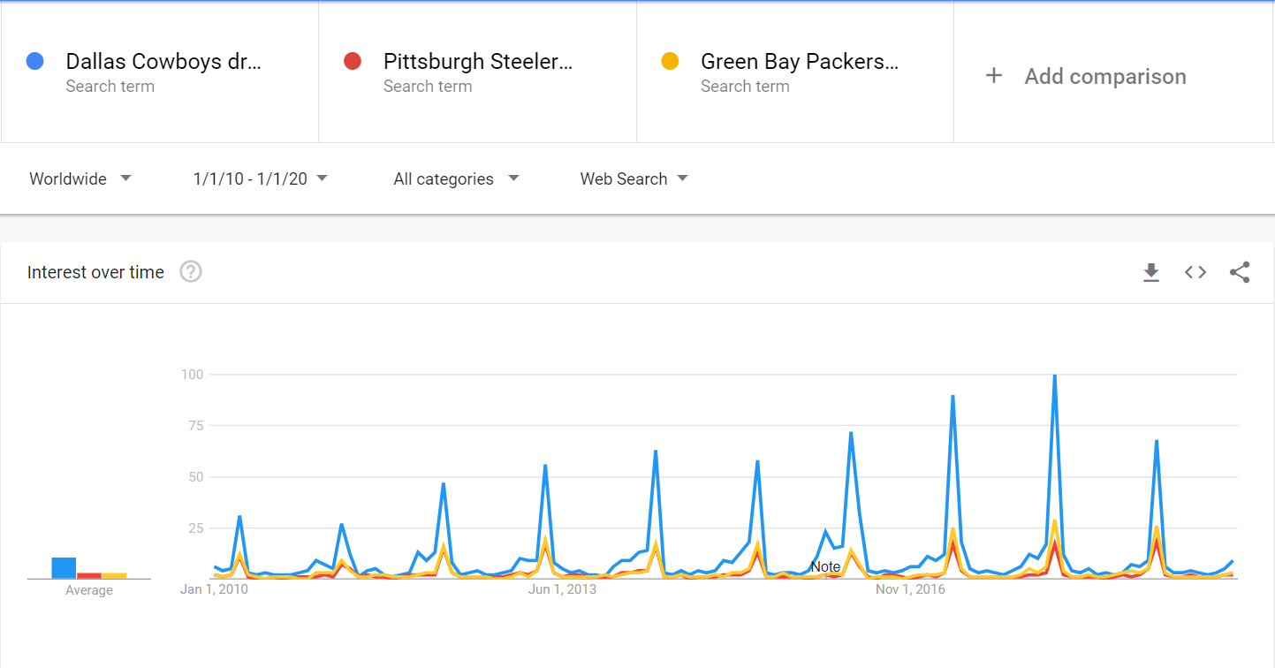
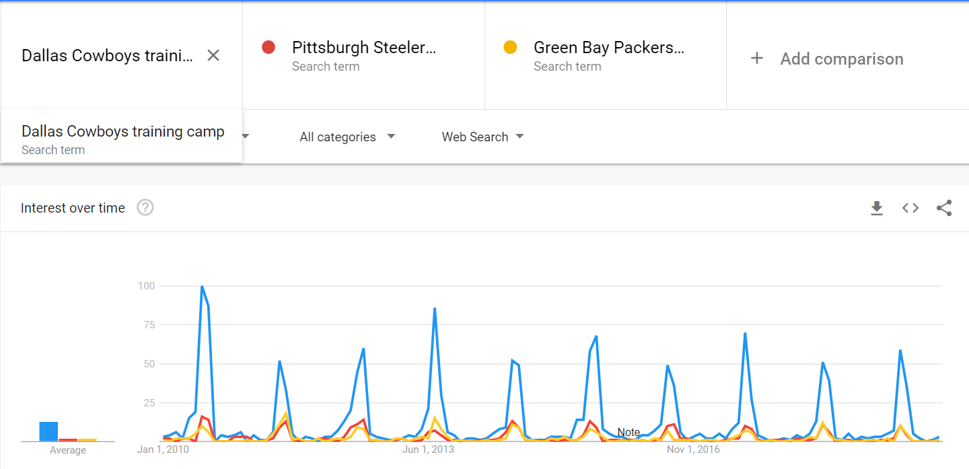
Looking more closely at offseason popularity, we look at searches for the draft and training camp
Another measure of popularity is sustained interest, not just interest during the season
Looking searches associated with each team related to the NFL draft and training camp, two offseason events, we see that the Cowboys definitely generate more interest than the Steelers and Packers

Slide 6
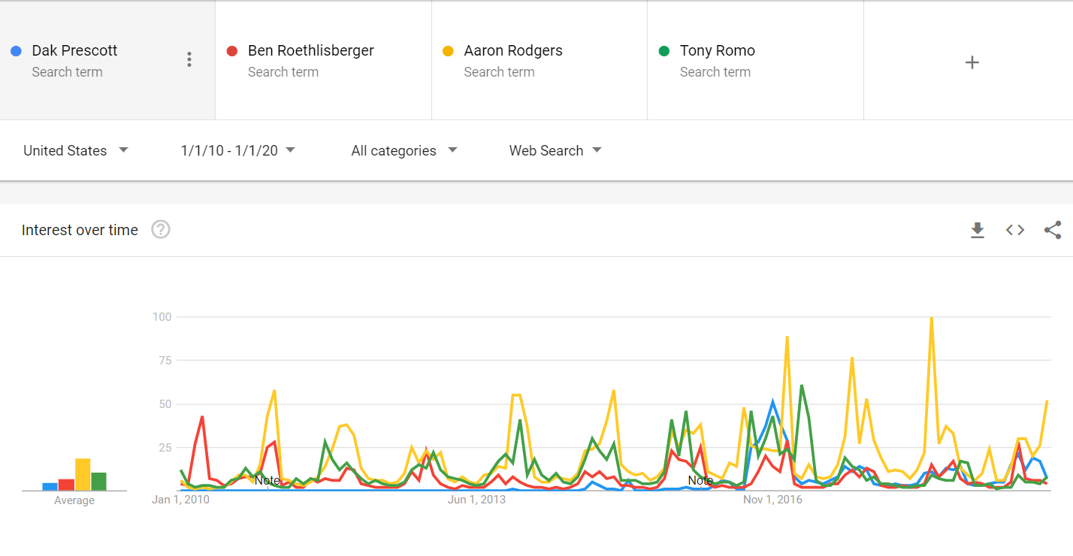
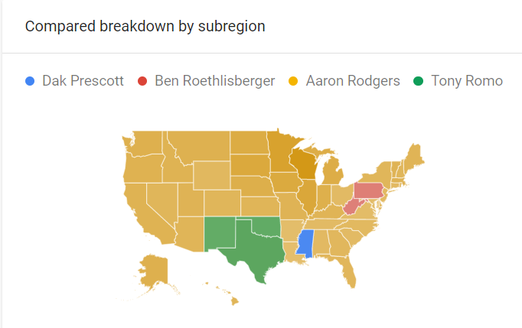
Comparing quarterbacks
As the quarterback of an NFL is generally the most popular player on the team, we look at how popular each of these quarterbacks has been over the last decade
While Ben Roethlisberger and Aaron Rodgers have been the quarterbacks for their teams over the last decade, the Cowboys has two main quarterbacks during this time: Dak Prescott and Tony Romo
Aaron Rodgers has clearly been the most popular quarterback over the last decade. In light of the previous findings, however, this suggests that the Cowboys are more popular, as their popularity was not based on the popularity of a single player

Slide 7
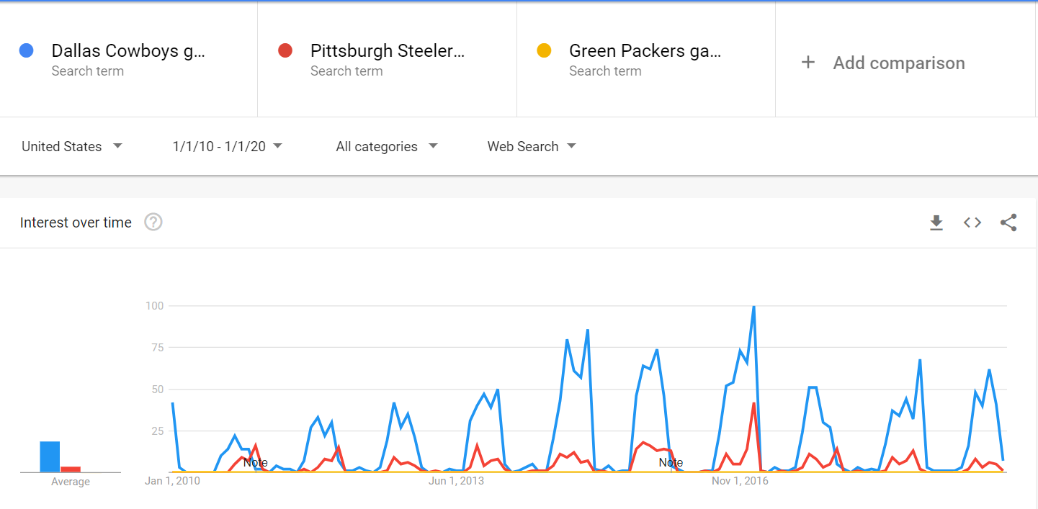
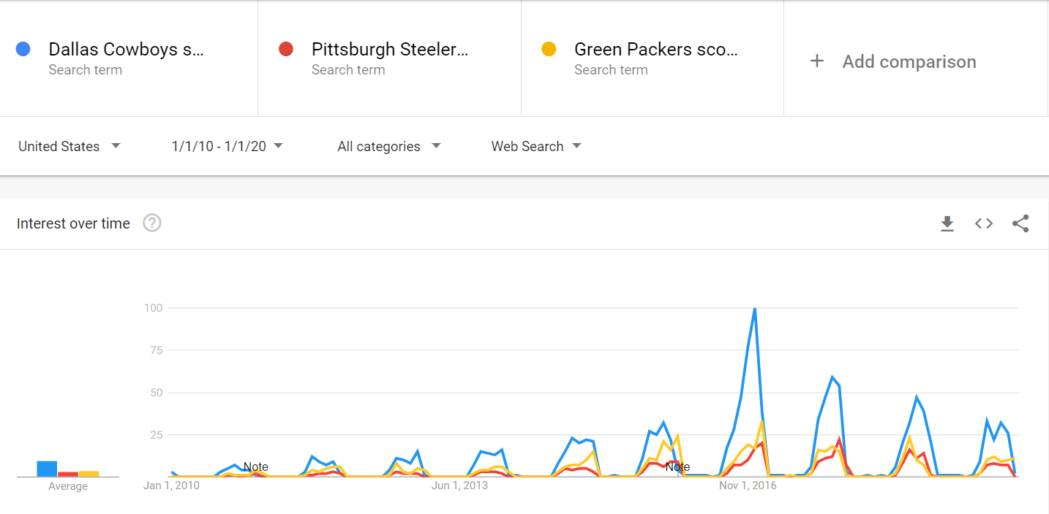
Game schedule and results
While viewership ratings can determine which teams draw the largest TV audience, many fans follow their teams by looking for results online
The top graph shows searches for the game time for each team, and the bottom is searches for game scores
The Cowboys consistently generate more interest in searches for game times
In terms searches for game scores, the Cowboys have definitely generated more interest in the last 5-6 years
The spike in the game score trends occurred during the 2016 when they went 13-3 and made the playoffs
They also made the playoffs in 2014 and 2018, which may help to explain the increased interest over the last 5-6 years

Slide 8
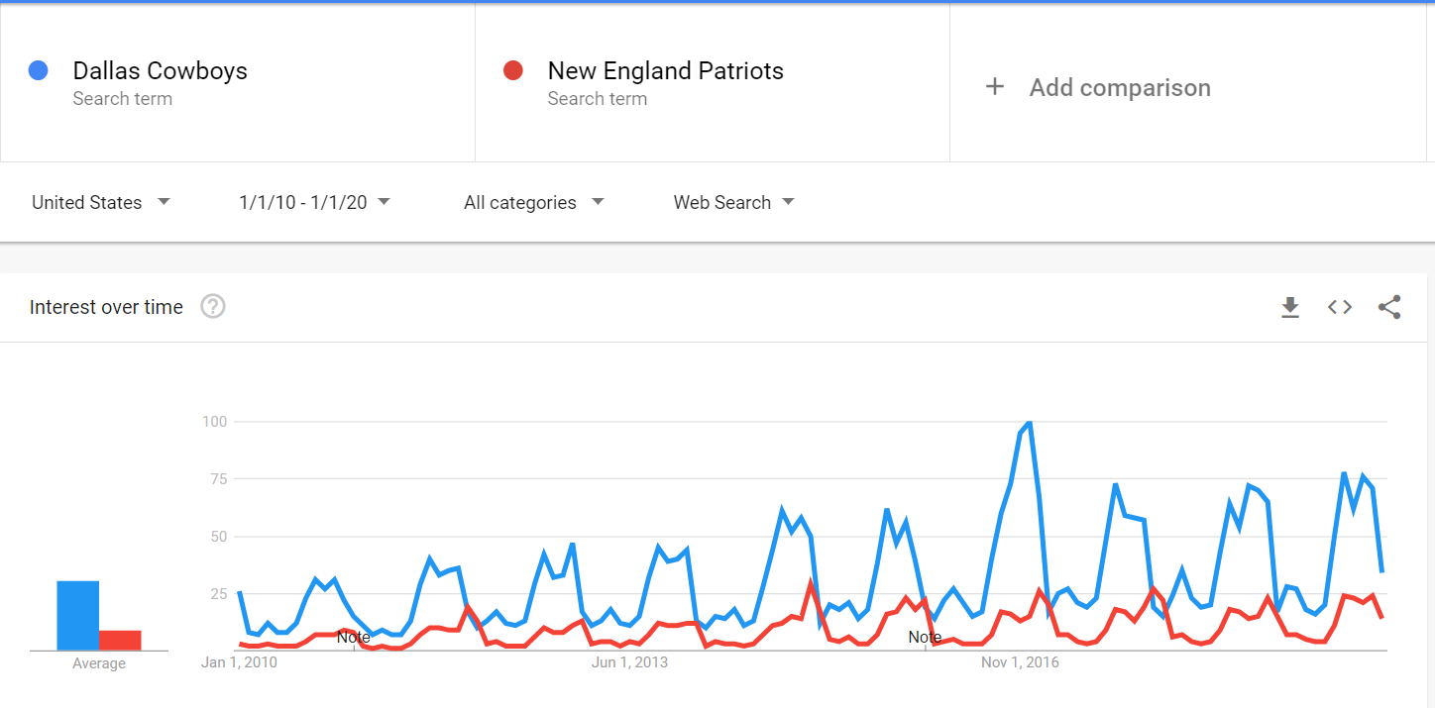
Comparing to the Patriots
Although I had decided to exclude the Patriots from the analysis due to their overwhelming success during the 2010-2020 period, I decided to conduct a post hoc analysis based on the conclusion that the Cowboys are clearly more popular than the Steelers and the Packers during that time, in spite of the fact that those teams experienced more success during that time
Surprisingly, the Cowboys seem to be even more popular than Patriots during this period

Slide 9
Further considerations:
When was each team in the playoffs?

